Slide 1



🚗 Obstacle Avoidance Robot using Arduino
Name: Avika Kaushik
College Name: CGC University Mohali
Subject: Minor Project
Guide Name: Vaishnavi
Next Slide

Slide 2
INTRODUCTION
An obstacle avoidance robot is an intelligent robot that detects obstacles using an ultrasonic sensor and automatically changes direction to avoid collision. This technology is widely used in robotics, automation, and self-driving systems.
Next Slide

Slide 3
Components Required
  Arduino UNO
  Ultrasonic Sensor (PING)))
  L293D Motor Driver
  2 DC Motors
  Battery
  Breadboard
  Connecting Wires
Next Slide

Slide 4
Software Used
  Tinkercad Circuits
  Arduino Programming Language
Next Slide

Slide 5
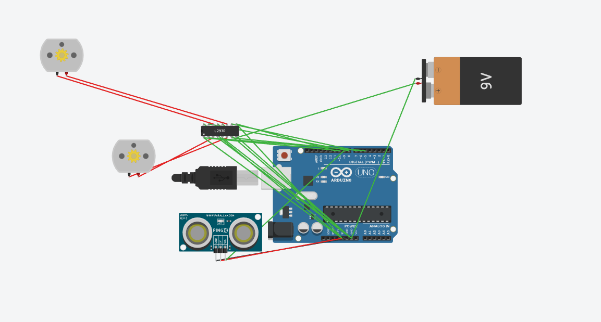
Circuit Diagram
Next Slide

Slide 6
Working Principle
  Ultrasonic sensor measures distance
  Arduino processes the signal
  If obstacle is near → robot turns
  If path is clear → robot moves forward
Next Slide

Slide 7
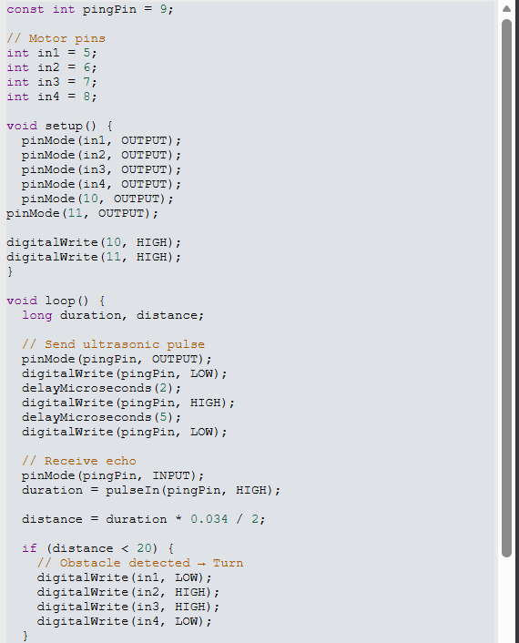

Arduino Code
Next Slide

Slide 8
Advantages
  Self-driving vehicles
  Industrial automation
  Military robots
  Cleaning robots
Next Slide

Slide 9
Conclusion
The obstacle avoidance robot successfully detects obstacles and changes direction automatically. This project demonstrates the use of sensors, microcontrollers, and motor control in robotics.
Next Slide

